Slide 1
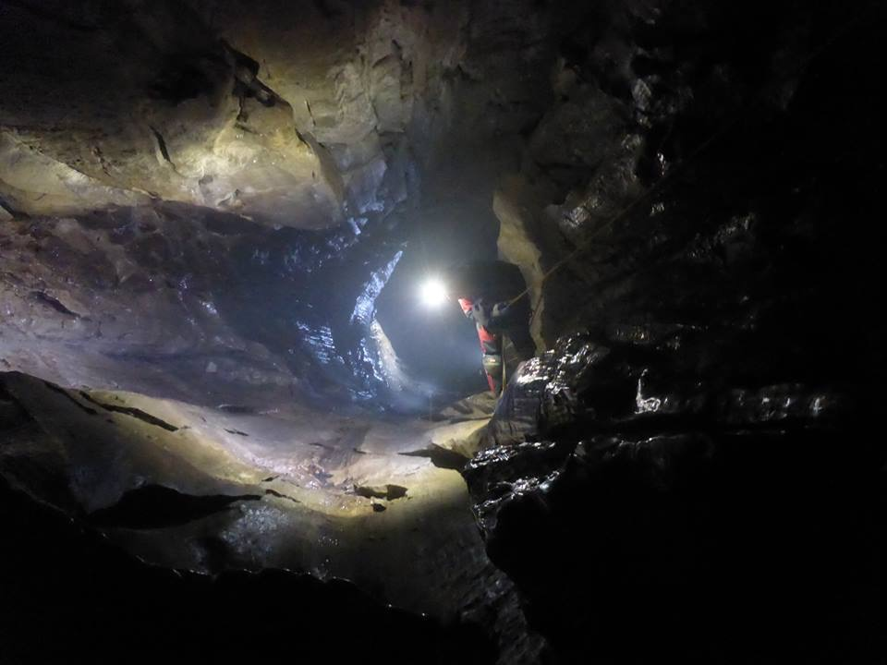
Coaching and CIC holders
CIC Panel 2021 based on initial work from Phil Baker

Slide 2
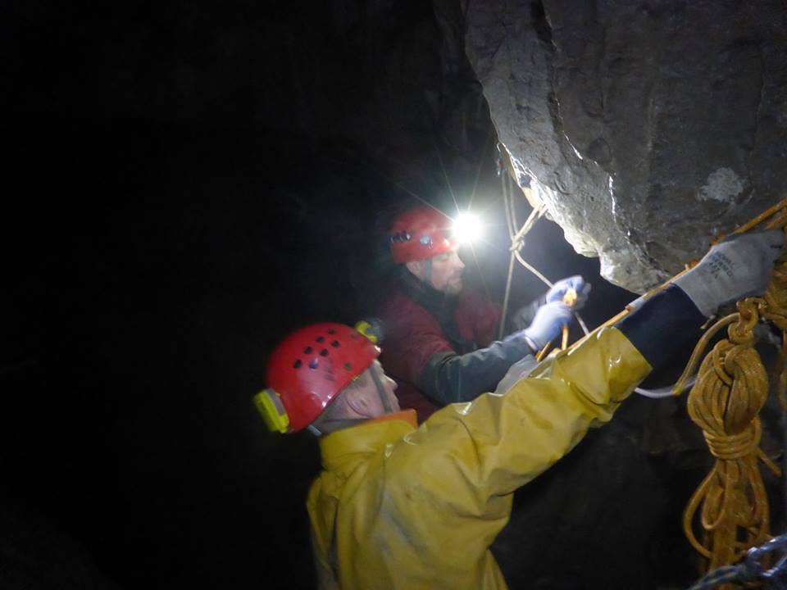
Coaching is…
“a process that enables learning and development to occur and thus performance to improve. To be successful, a Coach requires a knowledge and understanding of process, as well as the variety of styles, skills and techniques that are appropriate to the context in which the coaching takes place.
Eric Parsloe, The Manager as Coach and Mentor (1999).

Slide 3
Getting your client to plan the session
What does the client want from the session?
Ask “If you got everything you want from this session, how would you know?”
Ask “What difference would that make to your caving?”

Slide 4
Feedback and measuring outcomes
Only the client can decide if the session was any use for them
Practitioners who rate themselves highly are often rated poorly by clients, and vice versa
Listen to what clients want from the session and give them what they tell you they need
Be patient and kind

Slide 5
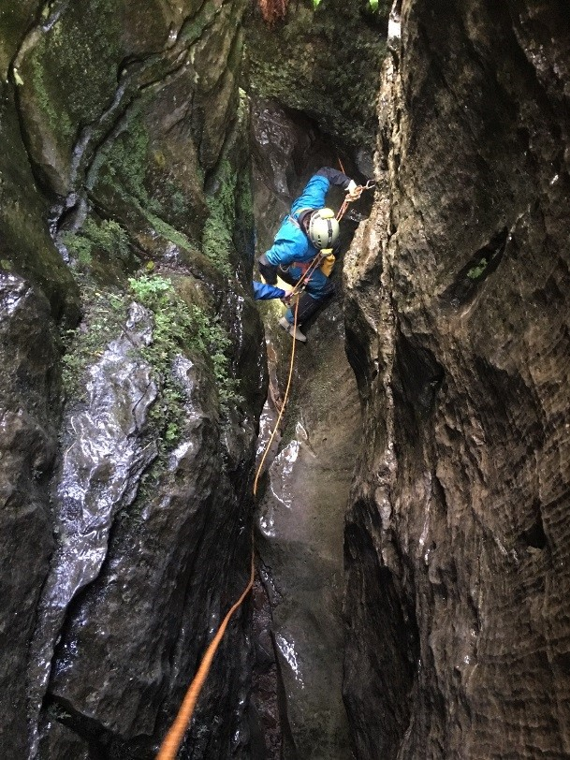
CLAP
Leadership needs to be safe and effective to coach well
Communication
Line of Sight (see relevant participants)
Avoidance or Awareness (of potential problems)
Position of maximum usefulness

Slide 6
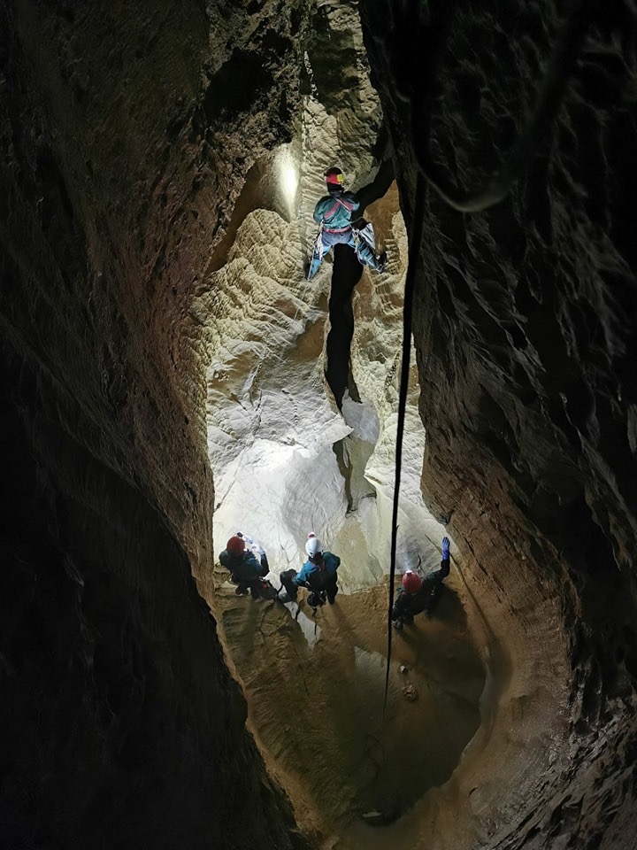
Coaching Mantras
PPPQA – does the session have
Pace
Purpose
Progression
Questioning
Analysis
Is it leading to
Safe
Effective
Efficient
Confident
cavers/techniques...

Slide 7
COACHING STYLES
There is a broad spectrum of coaching styles from Command where the coach is making all of the decisions, to Learner initiated where the coach is acting as a mentor. Command styles tend to be more about instruction than coaching, which demands patient dialogue.
So for a CIC teaching SRT to a novice the style will be very command when helping a student put an SRT kit on but observing a caver rig a new pitch after a previous training session the coach may use questioning/affirmation in a guided discovery style.

Slide 8
Coaching style | Interaction | Role of Coach | Role of Participant
Command (A) | Coach’ makes decisions. Participant copies and complies with decisions and instructions | Instructing | Copying
Practice (B) | Coach sets up opportunities giving feedback to a participant who is working at own pace on tasks set. | Establishing | Repeating and Improving
Reciprocal (C) | Participants work together, receiving feedback from each other. Coach provides reference points for feedback | Supporting | Performing and peer assessing
Self-Check (D) | Coach agrees criteria for success. Participants check own performance against these. | Directing | Self-assessing
Inclusion (E) | Coach sets out a variety of tasks/opportunities. Participants select which task is most appropriate for their abilities and/or motivations. | Questioning | Selecting

Slide 9
Coaching style | Interaction | Role of Coach | Role of Participant
Discovery (F) | Coach uses questions and tasks to gradually direct participants towards a pre-agreed learning target | Questioning | Uncovering
Divergent (G) | Coach sets or frames problems. Participants attempt to find most appropriate solutions. | Guiding | Finding Out
Individual Program (H) | Coach sets or frames problems. Participant attempts to create possible solutions. | Prompting | Creating
Learner Initiated (I) | Coach agrees on area of focus. Participants develop within this area, drawing on coach’s expertise | Advising | Initiating
Self-Learning (J) | Participants decide on how and what they are aiming for. Coach drawn on for support as needed | Mentoring | Deciding
Self Teach (K) | Participants engage in development on their own. | N/A | Self Determined

Slide 10
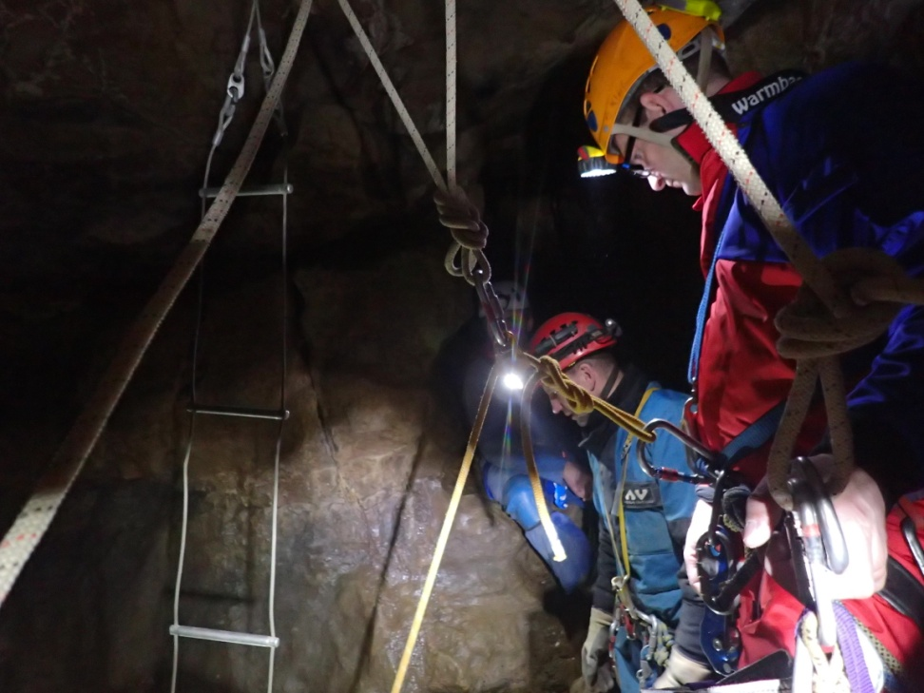
Coaching Styles
Autocratic Style - Telling
When using the Telling style the coach:
decides on what is to be done and what is important
defines what to do and how to do it- clients’ wants (not needs) ignored

Slide 11
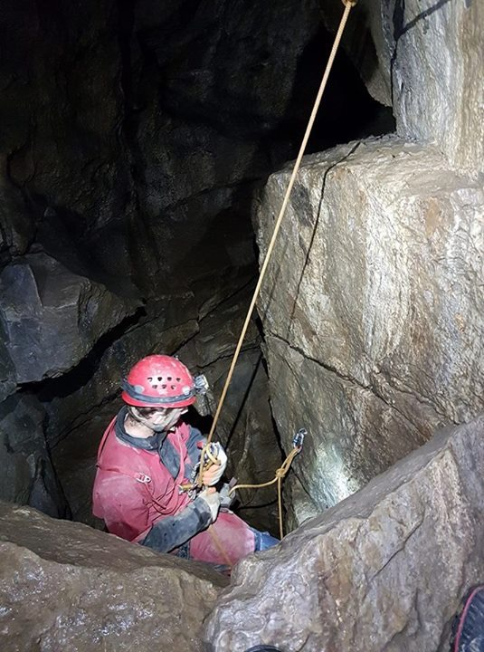
Coaching Styles
Autocratic Style - Selling
When using the Selling style the coach:
decides on what is to be done
explains what is required and the objectives
ask clients questions to confirm their understanding
defines what to do and how to do it

Slide 12
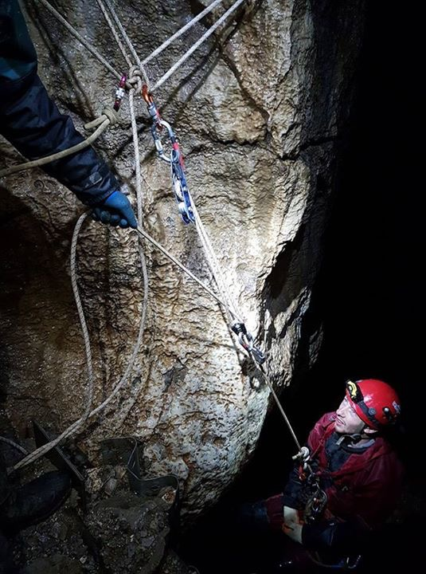
Coaching Styles
Democratic Style - Sharing
When using the Sharing style the coach:
outlines training requirements to participants
invites ideas/suggestions from the participants
makes decisions based on participants' suggestions
defines what to do and how to do it

Slide 13
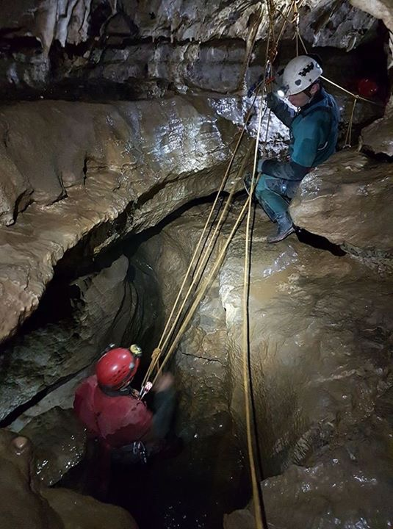
Learning Preferences
Coach should take these into account and adapt.
Visual...watchers
Audio... listeners
Kinaesthetic....hands on ...doers
Readers… learn from books

Slide 14
Learning Styles 2
ACTIVIST- Learn by doing, they have to be active.
REFLECTOR- hangs back watching and may want a few demonstrations before trying.
THEORIST- asks lots of questions before trying.
PRAGMATIST – not too bothered about why as long as it works.

Slide 15
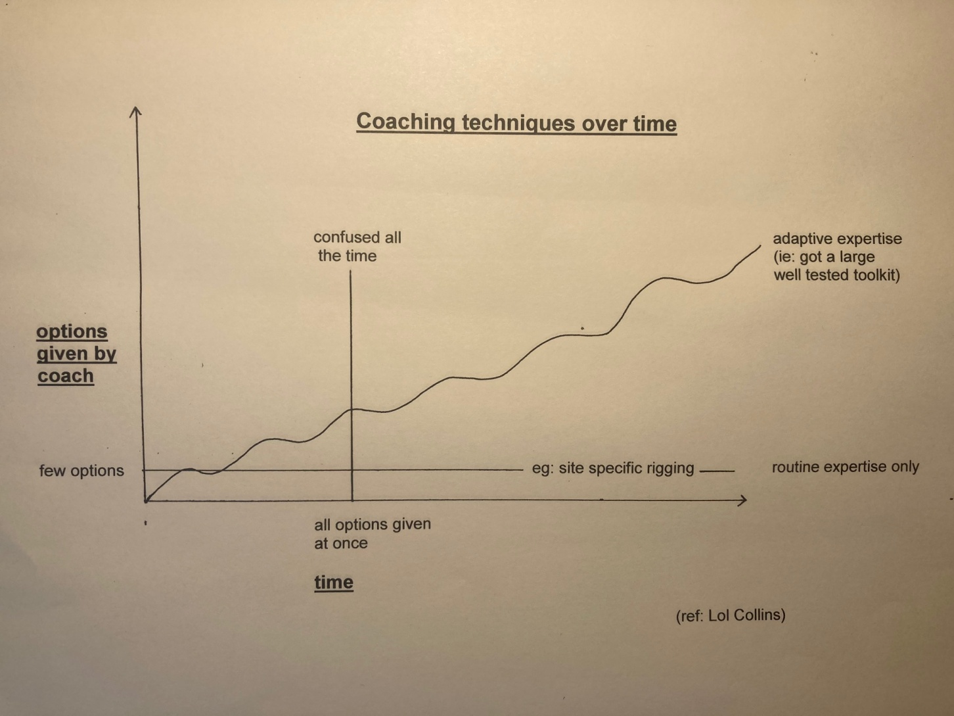
How much input – and when?

Slide 16
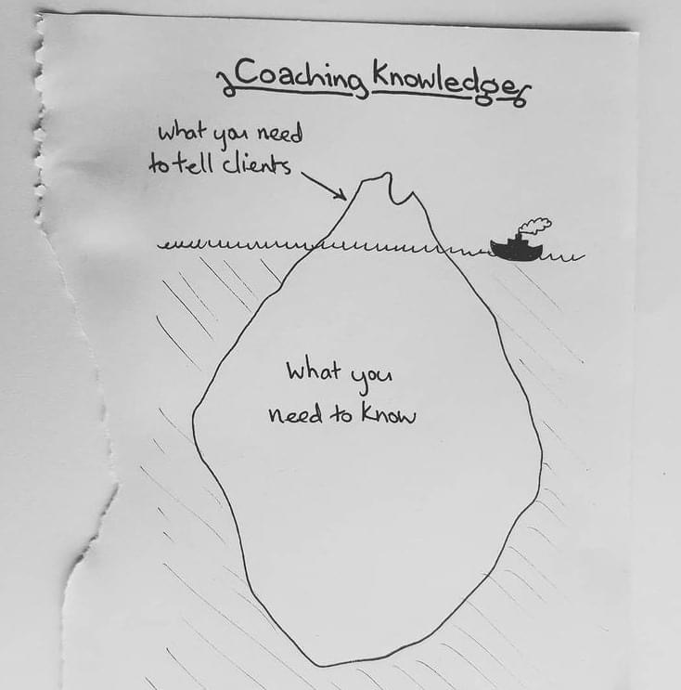
Coaching Knowledge

Slide 17
Feedback
These are two of the ways we can receive feedback.
Intrinsic-from ourselves, for example, that felt smoother, that was harder than usual, lightbulb moment.
Extrinsic- from others, peers, coaches, an achievement, video.
Feedback needs to be given for a reason - development
Feedback needs to be S.M.A.R.T.
Use of Questioning- This allows the client to develop a higher understanding of what they are doing rather than the coach telling them all the time. We are coaching an adventurous activity where we are expecting the client to leave us and go and participate independently in a harsh environment. We should ensure the clients know what they are capable of doing and what they should not be attempting when they leave us.

Slide 18
Feedback 2
S- Specific, for example, if someone has rigged a traverse line into a Y hang and everything is under tension tell them that “the good thing is everything is tensioned” don’t just say good. Equally, if the “y” hang is too low say that “it is too low as it prevents the ascending caver from getting off the pitch and onto the traverse line easily”.
M-Measured, for example, “did you put more or less effort into that ascent compared to the last pitch?”
A-Achievable, for example, Don’t expect miracles. The caver shouldn’t be expected to perform a mid rope changeover if they have only just put an SRT kit on for the first time, but they should remember to tighten their chest harness once suspended.
R-Realistic, for example, don’t give too much information. Keep it short and simple.
T- Timely, given at the correct time (see below). Environmental considerations as well, such as not in the middle of a wet pitch.
Hot Feedback - given at the time. If someone does something well a quick, well worded, piece of feedback is good, or a quick stop if something is likely to lead to an unsafe situation. This should not be a long distracting piece of feedback.
After the event- when a client has finished a task allow them to stop and compose themselves and then the coach and participant can have a conversation.

Slide 19
Quality Coaching….in reality?
Planning →
Prior assessment →
Session assessment →
Range of styles and techniques →
Individual and group engagement→
Review →
setting up the coaching environment
where they say they are
where they actually are
demonstrations/instructions/ questioning/explore/feedback
busy clients
action plans

Slide 20
The 4 P’s…
Perfect Practice makes for Permanent Perfection
And....
Encourage (and demonstrate) best practice
When teaching, never say ‘normally I’d use a screwgate here….’ or
‘normally I’d tie that off’...….they’ll mostly remember what they see not what you say

Slide 21
TRAINING AND ASSESSMENT
Part of the work of a CIC is training and assessing LCMLA candidates and others for site specific assessments.
Be accurate and do not personalise things.
You are assessing against a syllabus (in the case of LCMLA)
Consistent vs one off mistake
It is OK to make a mistake, no one is perfect, and no one expects 100%
Get quality evidence to give quality feedback - record events of the assessment, write things down, take pictures and explain to candidates that a lot of writing does not mean a lot of mistakes, that you are writing to give accurate feedback and result.

Slide 22
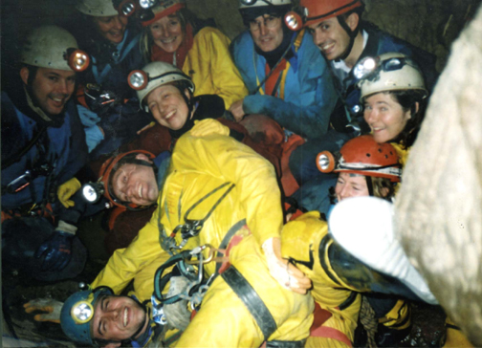
Finally...aim to create a relaxed learning environment

